Slide 1
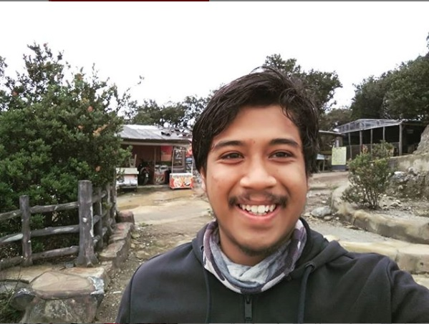
Welcome to IoT World for SMKDT STUDENT
Content :
What is IoT
What is Blynk app and Arduino IDE
Installing Blynk app and Arduino IDE
Installing ESP32 library and blynk on Arduino IDE
Checking ESP32 work or not using blink code and how to upload
C++ Arduino IDE programming‘s rules
Basic Instruction (analog & digital read&write)
Blynk integration code (turn on off lamp from android)
SMKDT’s IoT Expo
Sundanese Jarvis (ardumeka founder’s expo)
Speaker : Muhammad Husni, S. Pd
Python Programmer
Alumni SMKDT Angkatan 4 (Geist In Vier)

Slide 2
About me
Name : Muhammad Husni Muttaqin, S. Pd.
Birth date : 5 June 1998
Hometown : Bandung
Current Job : Python programmer at PT Syergie Indoprima
Experiences : - 2019 : Dynamics Positioning System control system engineer on cable ship kalibaru – untung jawa 20Kv cable installation (PT Syergie Indoprima)
- 2019 : Dynamics Positioning System control system engineer on cable ship lampung – pahawang 20Kv cable installation (PT Syergie Indoprima)
- 2020 : Dynamics Positioning System control system engineer on cable ship palapa ring tengah cable maintenance (PT Syergie Indoprima)
- 2021 - 2022 : Electronics and control system engineer for Vent-I (PT Syergie Automa Teknologi)
- 2022 : python programmer

Slide 3
Ppt + source code on :
https://github.com/muhammadhusni777/SMKDT-IOT-CLUB

Slide 4
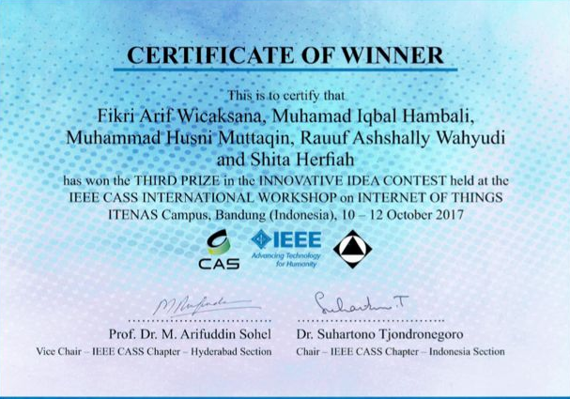
My achievement on electronics and IoT World
- 3 rd winner on International innovative IoT idea 2017

Slide 5

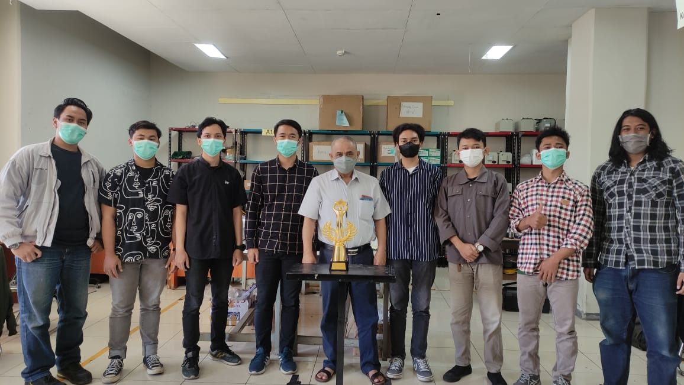
My achievement on electronics and IoT World
- Metro tv award : scientific problem solving on pandemic (Vent-I ITB Team)

Slide 6
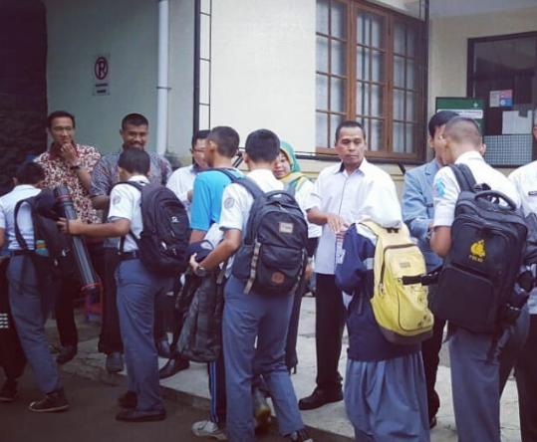
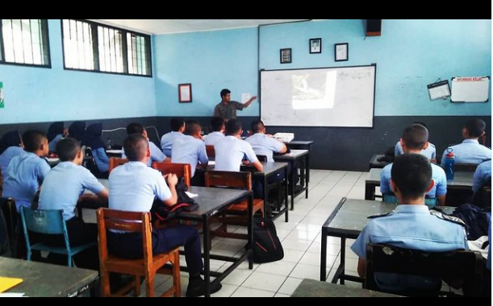
Teaching experience : Elektronika Pesawat Udara SMK12 Bandung

Slide 7
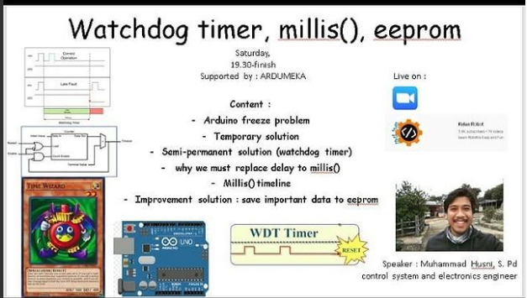
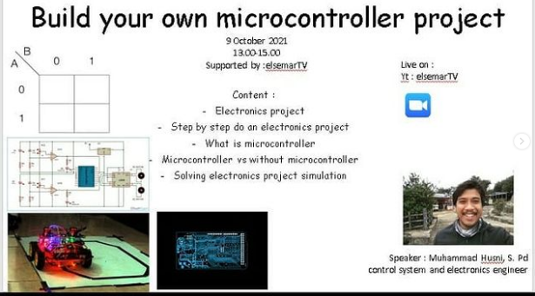
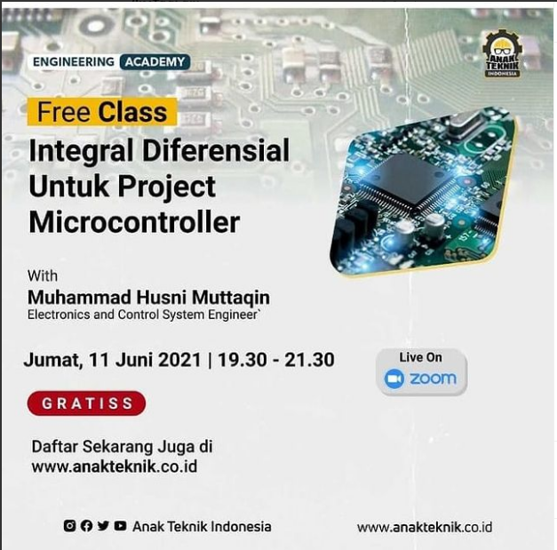
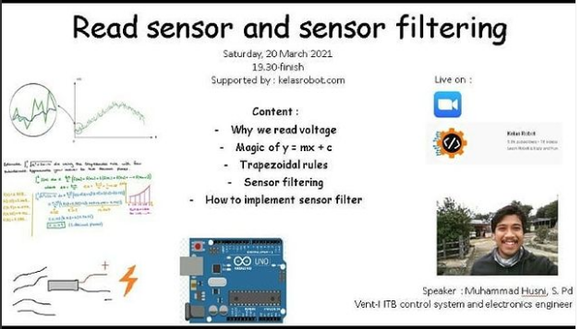
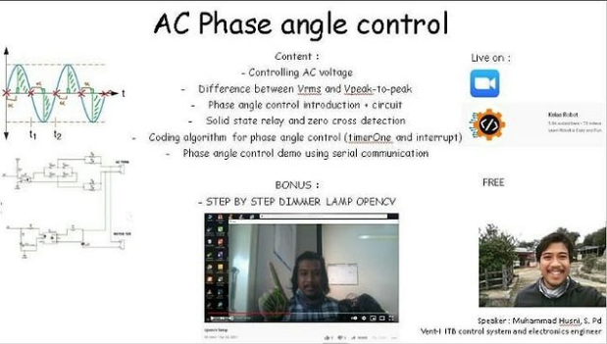
Teaching experience : Founder Ardumeka

Slide 8
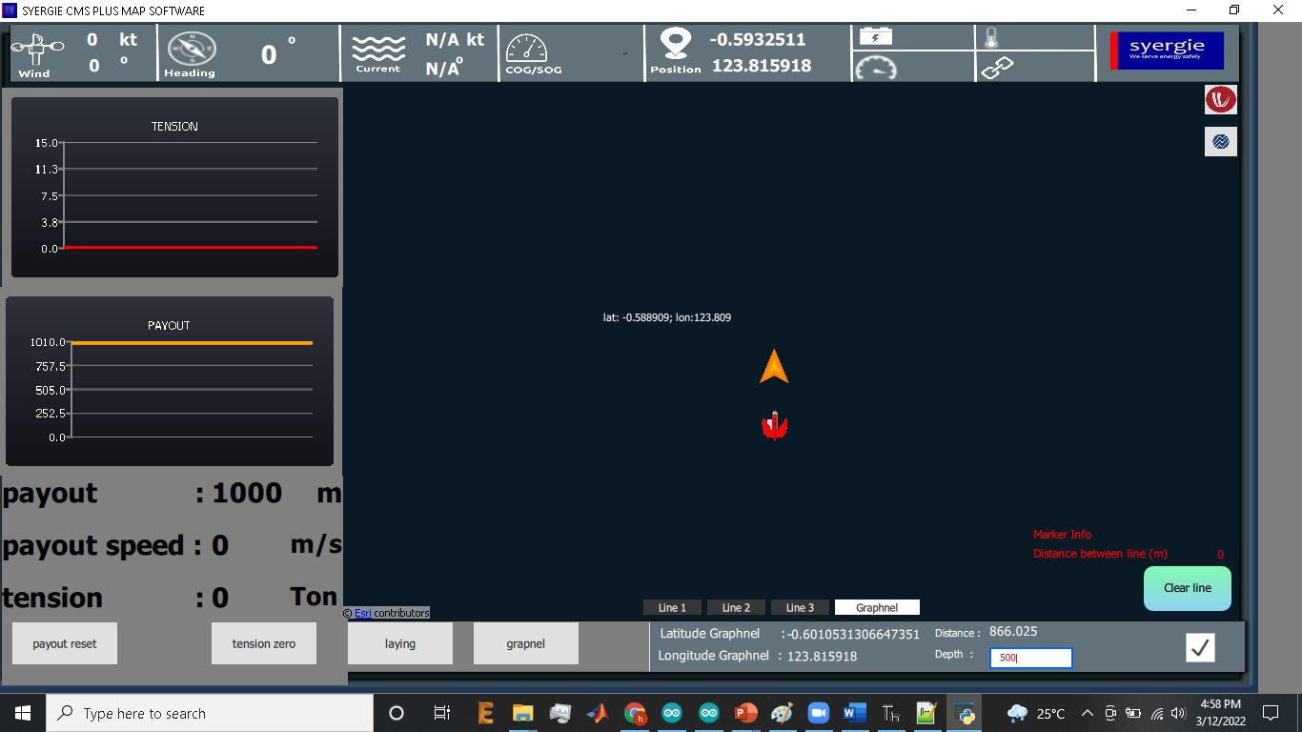
Current Project

Slide 9
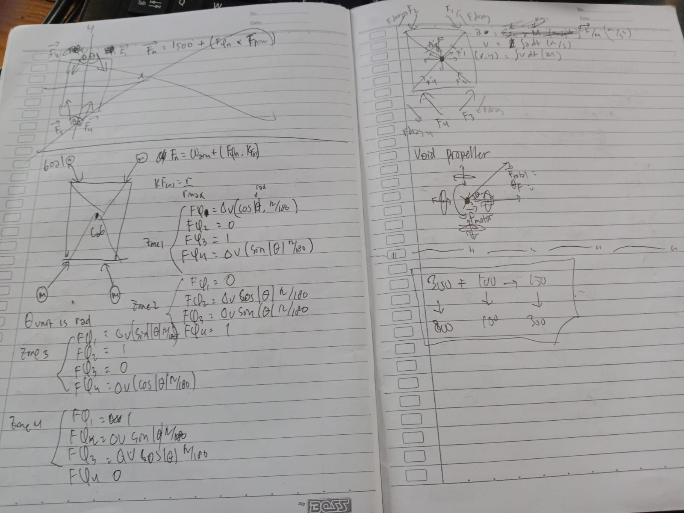
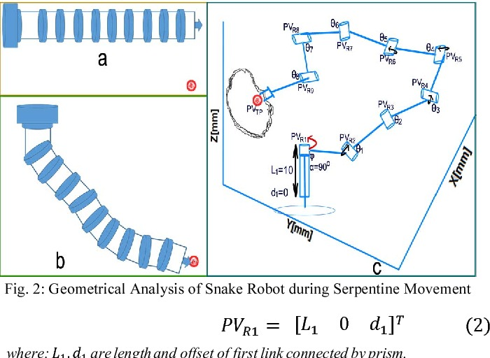
Current projects
Find control equation for new generation ship propeller

Slide 10
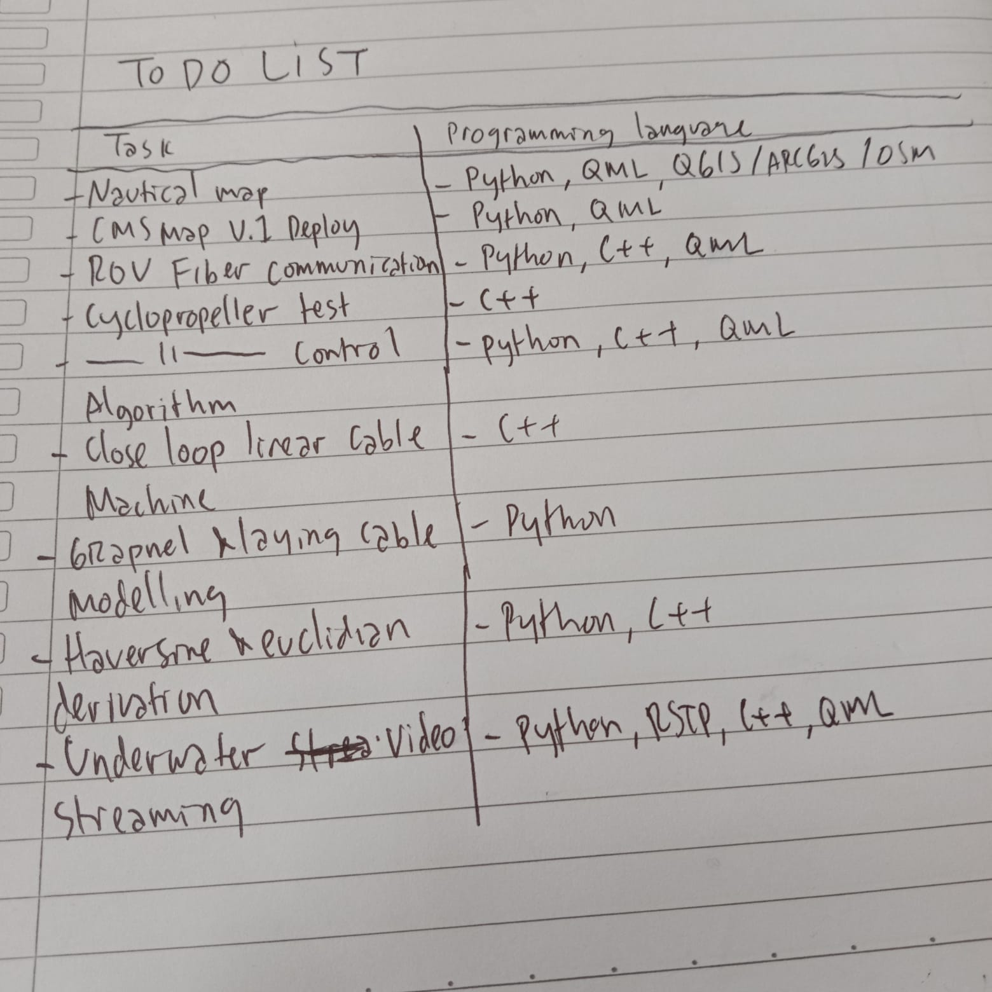

Slide 11
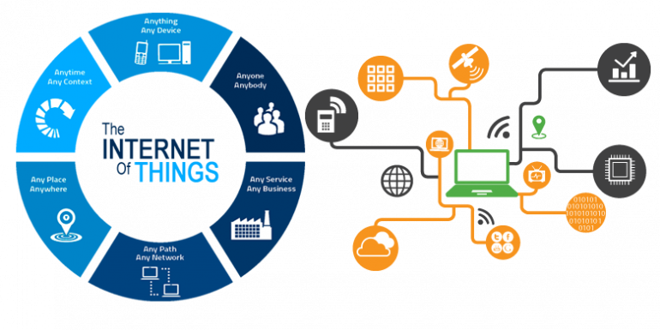
What is IoT
Internet of things
Turn light, home appliences

Slide 12
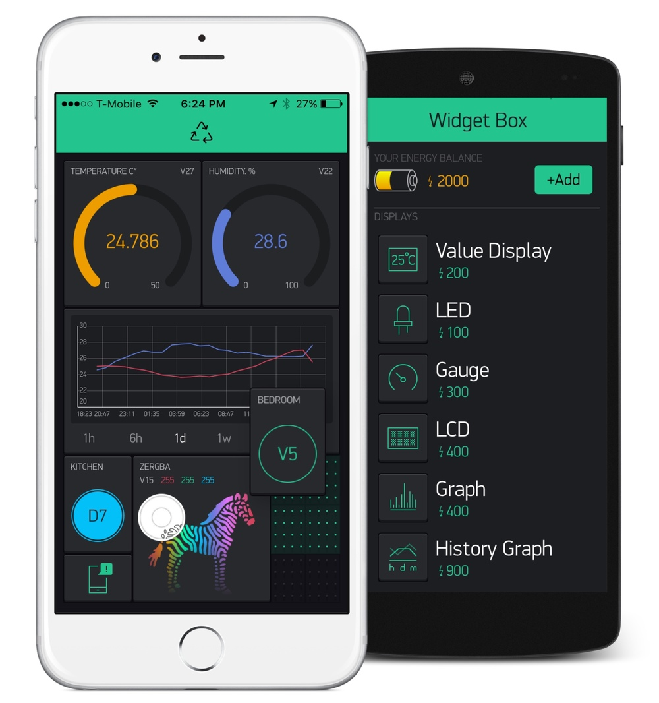
What is Blynk app
Go to playstore, search blynk IoT, install Blynk legacy

Slide 13
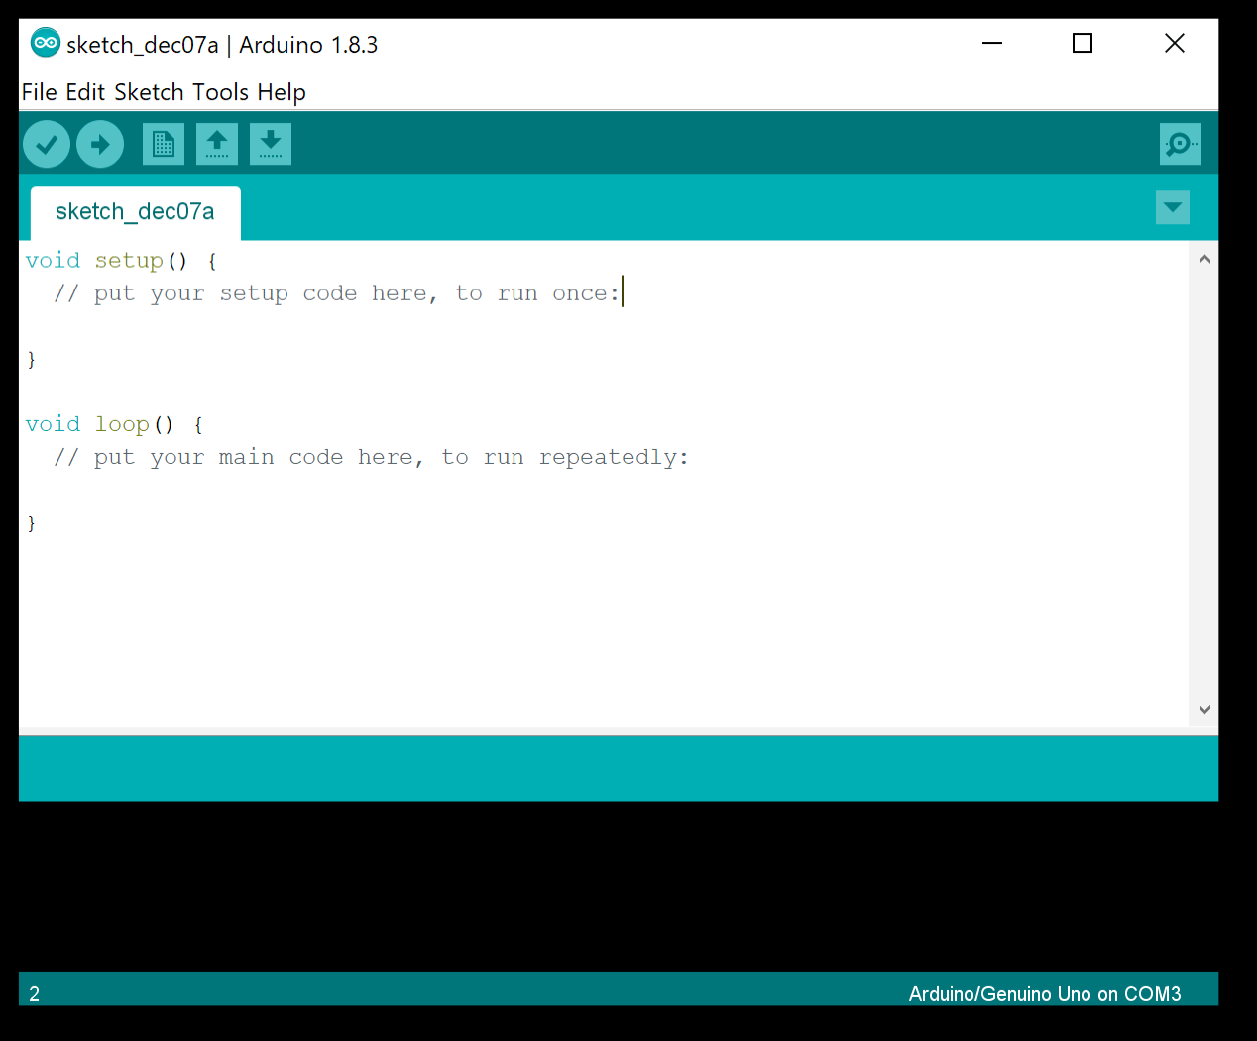
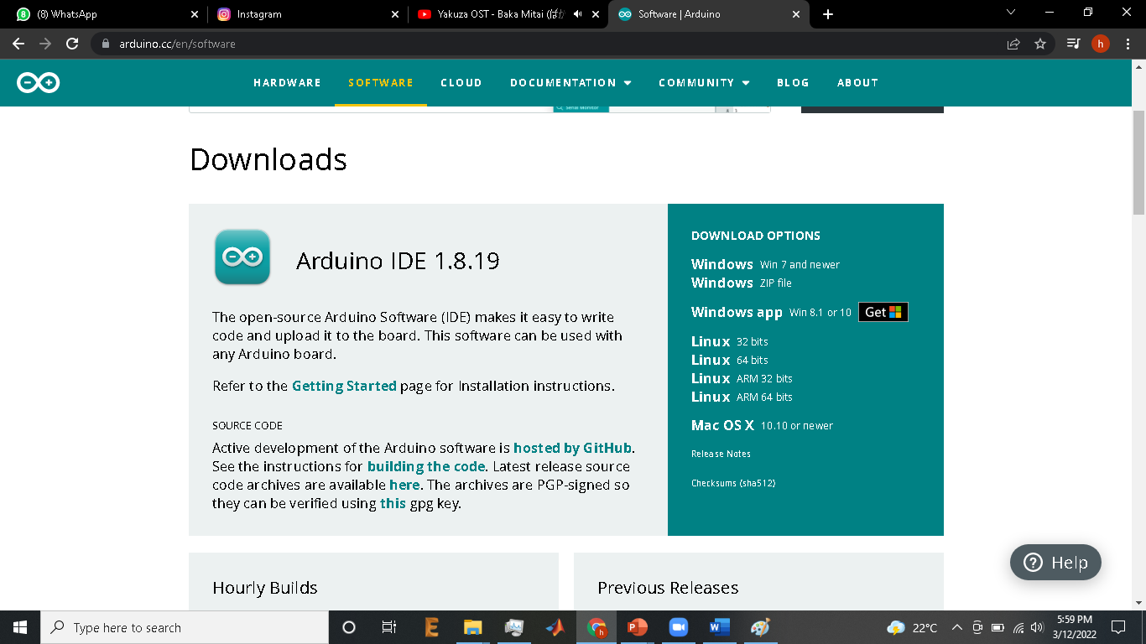
What is Arduino Ide
https://www.arduino.cc/en/software

Slide 14
Install COM driver
Install CP2102 (https://exploreembedded.com/wiki/Cp2102_Usb-to-Serial_Driver_Installation)
Install CH340 (https://kelasrobot.com/cara-install-usb-driver-ch340g-ch340-untuk-arduino )

Slide 15
Install ESP32 board library
https://randomnerdtutorials.com/installing-the-esp32-board-in-arduino-ide-windows-instructions/
Json file : https://dl.espressif.com/dl/package_esp32_index.json

Slide 16
Install Blynk library arduino
Common problem solving : https://kelasrobot.com/solved-cara-mengatasi-error-login-timeout-blynk/

Slide 17
Basic Instruction (analog & digital read&write)
Analog read : read 0-3.3 volt (ESP32), read 0-5 volt (Arduino nano/mega/uno)
Analog Write : give 0-3.3 volt (ESP32, give 0-5 volt (Arduino nano/mega/uno)
Digital read : read 0 AND 3.3 volt (ESP32), read 0 AND 5 volt (Arduino nano/mega/uno)
Digital Write : give 0 AND 3.3 volt (ESP32, give 0 AND 5 volt (Arduino nano/mega/uno)

Slide 18
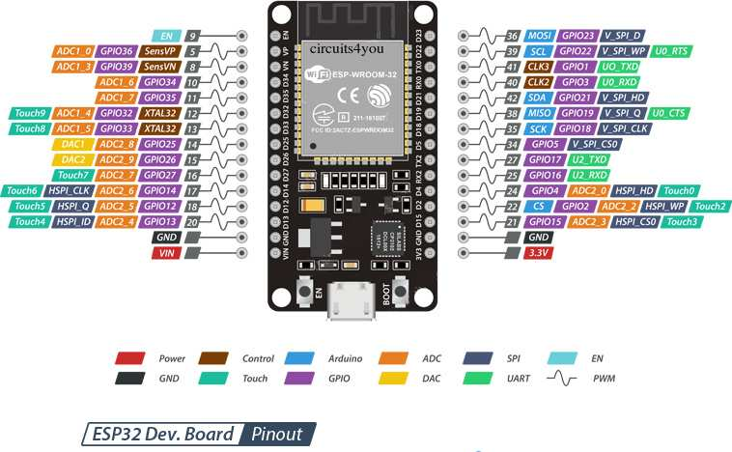

Slide 19
Analog Read
void setup() {
Serial.begin(9600);
}
void loop() {
int sensorValue = analogRead(A0);
Serial.println(sensorValue);
}

Slide 20
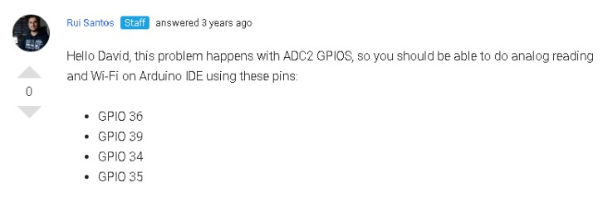
trap ☺

Slide 21
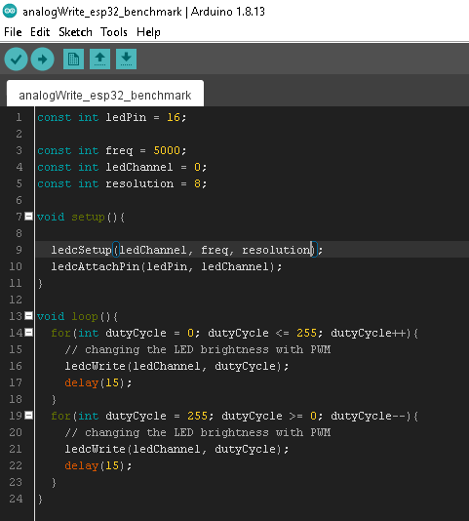
Analog Write (ESP32)

Slide 22
Analog Write (Arduino microcontroller)
Int lampu = 6;
void setup() {
pinMode(lampu, OUTPUT);
}
void loop() {
analogWrite(lampu, 0);
delay(1000);
analogWrite(lampu, 255);
delay(1000);
}

Slide 23
Digital write
Int lampu = 2;
void setup() {
pinMode(lampu, OUTPUT);
}
void loop() {
digitalWrite(lampu, HIGH);
delay(1000);
digitalWrite(lampu, LOW);
delay(1000);
}

Slide 24
Digital read
int pushButton = 5;
void setup() {
Serial.begin(9600);
pinMode(pushButton, INPUT_PULLUP);
}
void loop() {
int buttonState = digitalRead(pushButton);
Serial.println(buttonState);
delay(1); // delay in between reads for stability
}

Slide 25
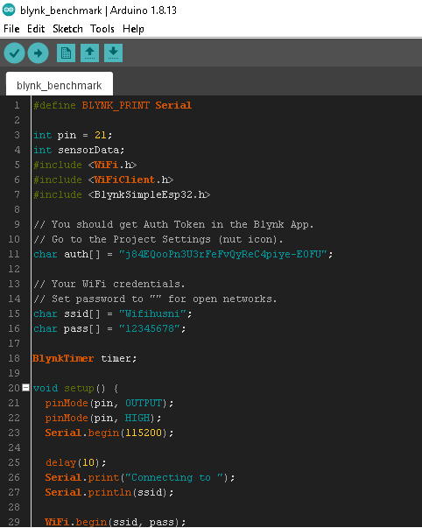
Blynk integration code (turn on off lamp from android)
Blynk_benchmark

Slide 26
SMKDT’s IoT Expo #1 (May’22)
Dorm Smart lamp
Dorm windows smart security system
Dorm smart water heater
Dorm smart Fan
Dorm Smart garden
Dorm smart water fill
Dorm smart Bin
Hand gesture lamp switch (ardumeka founder’s + SMKDT ALLSTAR expo)
Sundanese Jarvis (ardumeka founder’s expo)

Slide 27
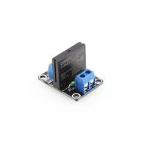



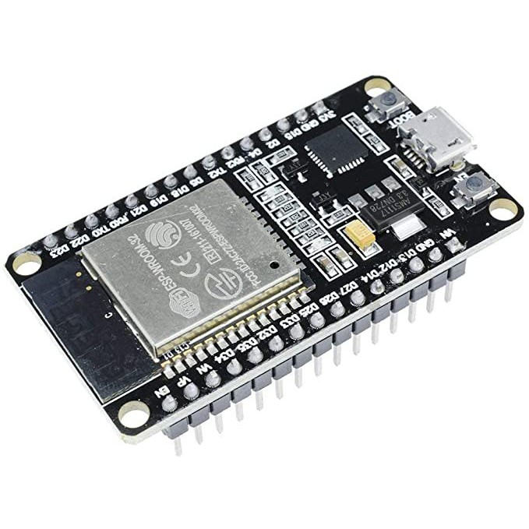
Stand 01 : Dorm Smart lamp

Slide 28
Stand 01 : Dorm Smart lamp
Objective :
- digitalWrite from blynk 3 or more objects (lamp)

Slide 29
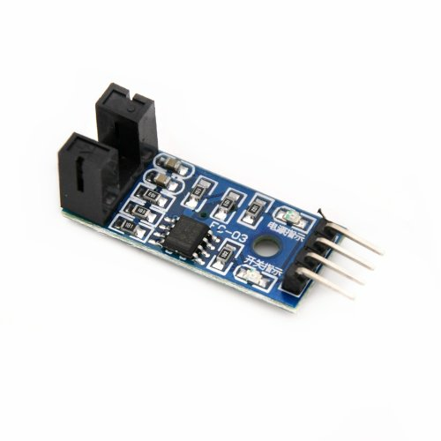
Stand 02 : Dorm windows smart security system

Slide 30
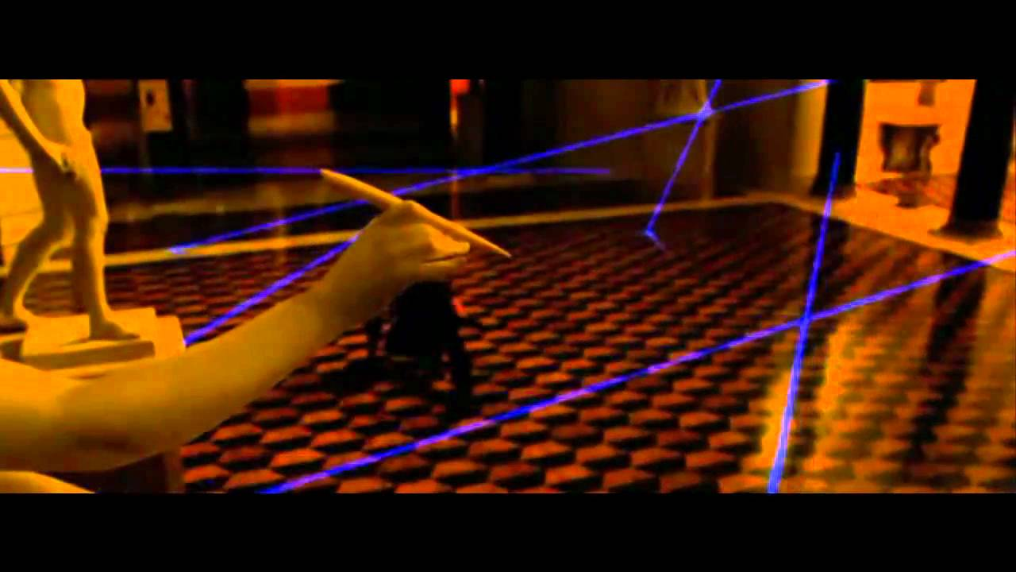

Slide 31
Stand 02 : Dorm windows smart security system
Objective :
Digital Read three or more object and send to blynk app
Give notification to blynk

Slide 32

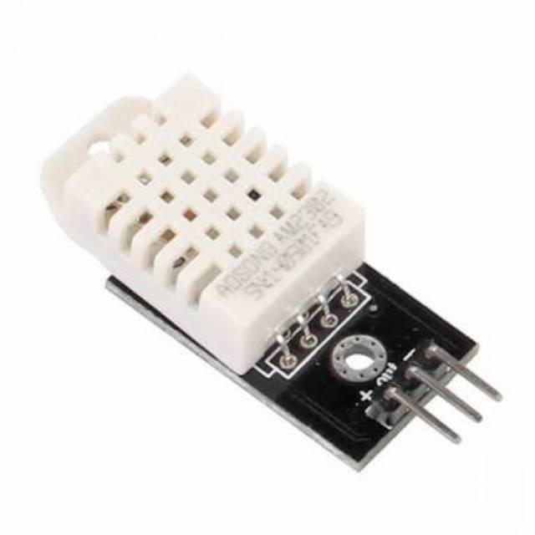
Stand 03 : Dorm smart water heater

Slide 33
Stand 03 : Dorm smart water heater
Objective :
Send target value to esp from blynk
Receive DHT 11/22 value from esp to blynk
Make if else statement to control the heater (turn off if sensor value above target value and vice versa)

Slide 34
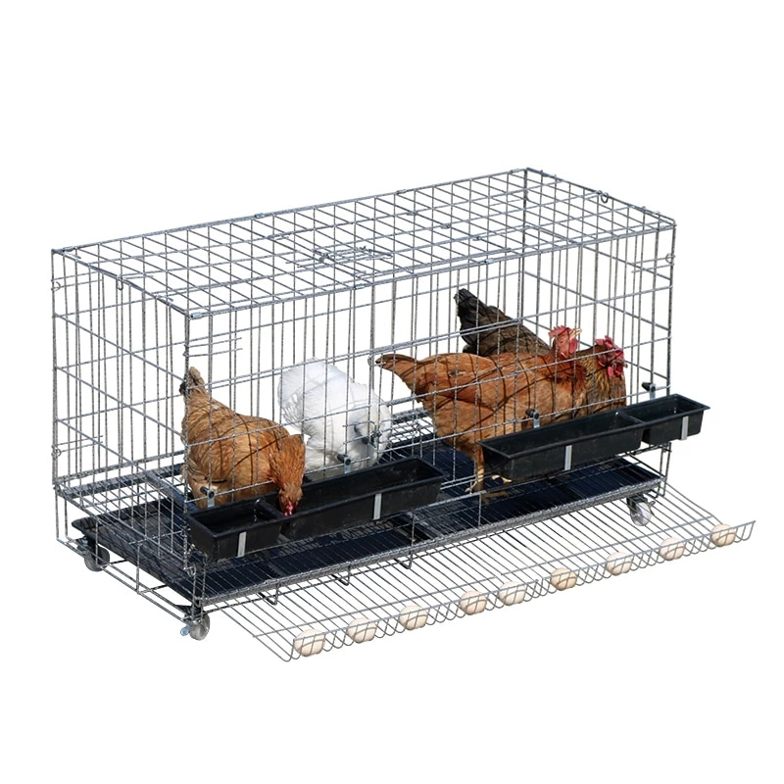
Optional :
https://create.arduino.cc/projecthub/dirakit_indonesia/saveyourchicken-b7da4d

Slide 35
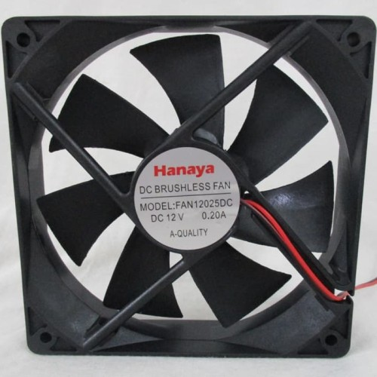
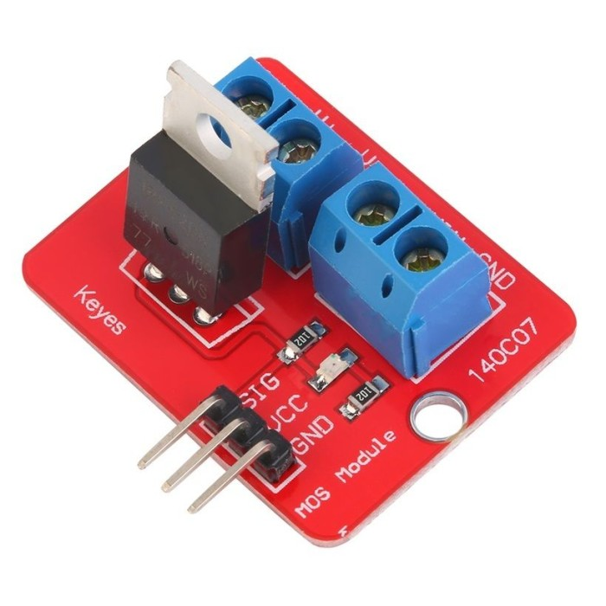
Stand 04 :Dorm smart Fan

Slide 36
Stand 04 :Dorm smart Fan
Objective :
- digitalWrite from blynk 3 or more objects (fan)

Slide 37
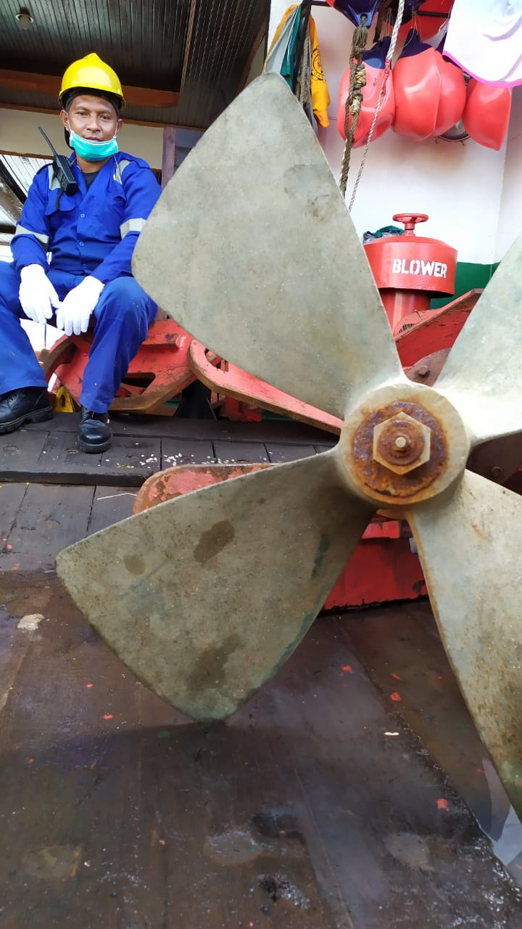

Slide 38
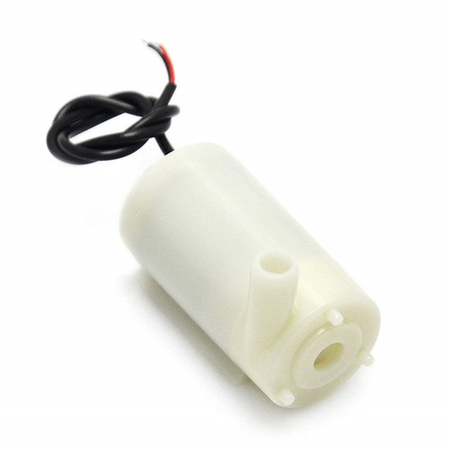
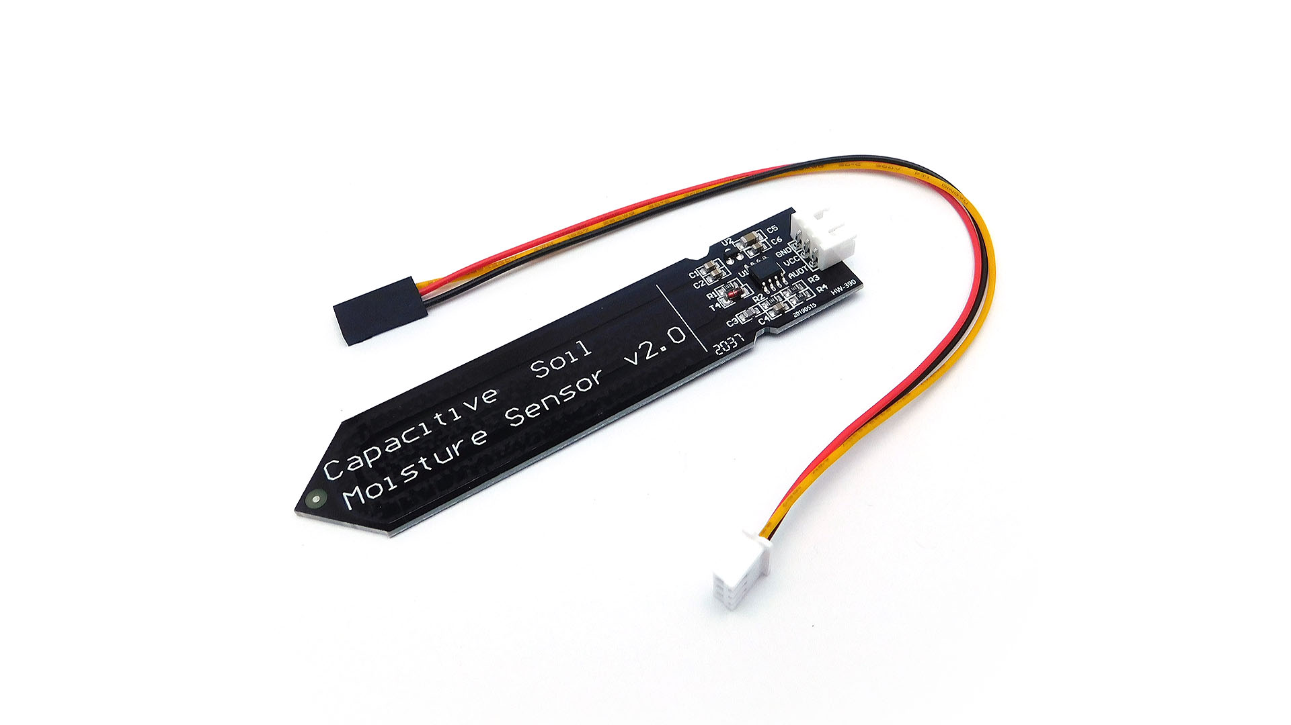
Stand 05 : Dorm Smart garden

Slide 39
Stand 05 : Dorm Smart garden
Objective :
Send target value to esp from blynk (soil moisture level)
Receive soil value from esp to blynk
Make manual mode. If blynk button turn on the pump will turn on
Make automatic mode. if else statement to control the pump (turn off if sensor value above target value and vice versa)

Slide 40
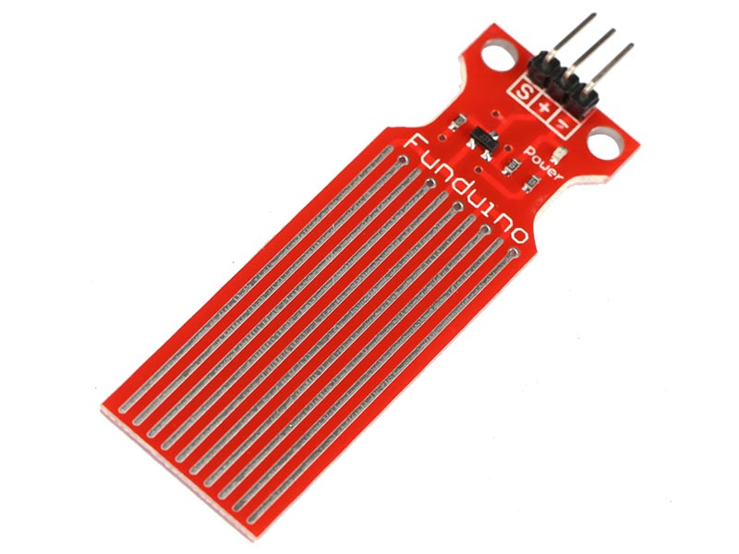
Stand 06 : Dorm smart water fill

Slide 41
Stand 06 : Dorm smart water fill
Objective :
Send target value to esp from blynk (water level)
Receive water level from esp to blynk
Make manual mode. If blynk button turn on the pump will turn on
Make automatic mode. if else statement to control the pump (turn off if sensor value above target value and vice versa)

Slide 42
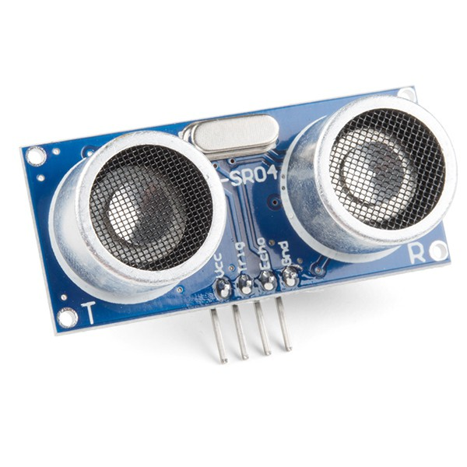
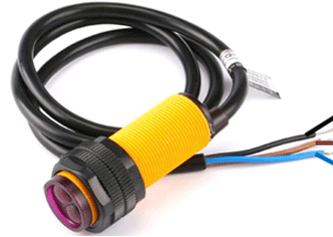
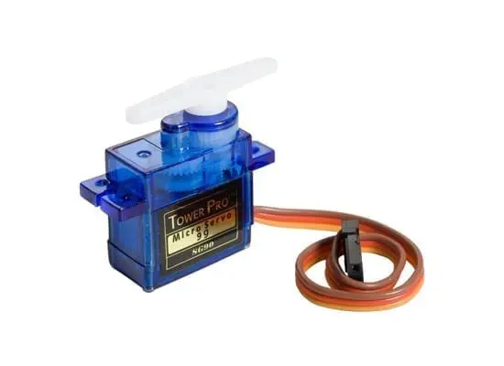
Stand 07 :Dorm smart Bin

Slide 43
Stand 07 :Dorm smart Bin
Objective :
Read proximity sensor
Trigger servo using proximity sensor
Send count number to blynk app

Slide 44


Stand 08 : Hand gesture lamp switch (ardumeka founder’s + SMKDT ALLSTAR expo)

Slide 45
Stand 09 : Sundanese Jarvis (ardumeka founder’s expo )

Slide 46
Sundanese Jarvis (ardumeka founder’s expo )
COMING SOON

Slide 47
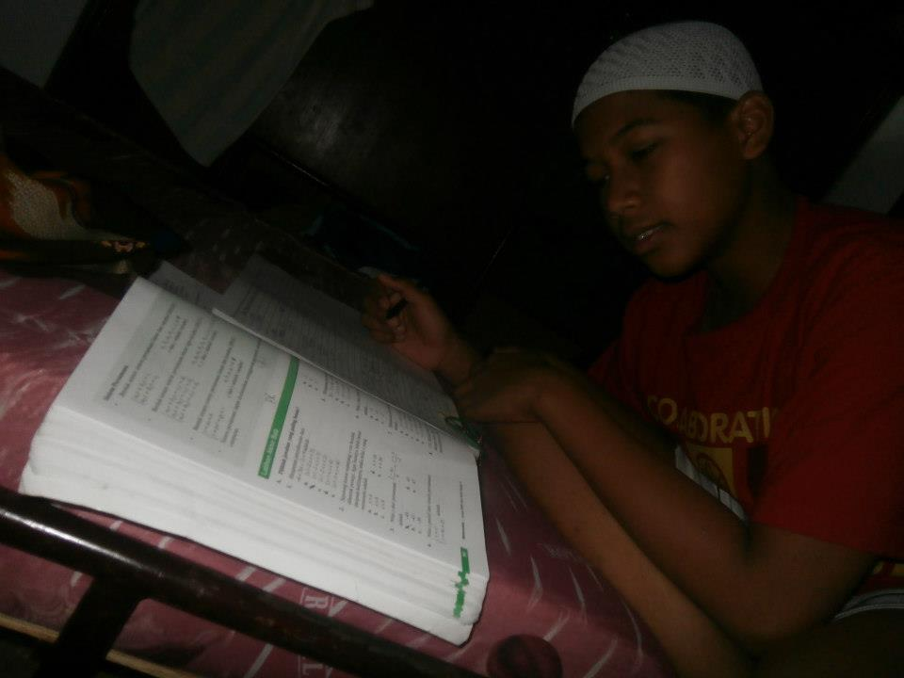
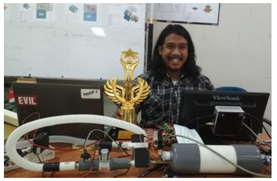
Never give up guys ☺

